Slide 1
Preparing for Registration: Are you on Track to graduate?
01/30/19 Advisement

Slide 2
Important upcoming dates:
Dual Enrollment Meeting
When: Thursday, January 31st
Where: Theatre, CHS
Time: 6:00pm
*If you are planning on or still considering Dual Enrollment next year please plan to attend the meeting. There will be representatives from UNG, Lanier Tech, Brenau, & Early College*
Come talk to your school counselor, Ms. Hamilton, if you have any questions!!

Slide 3
Important Upcoming 2019-2020 Registration dates:
February 19 – Registration Begins
Extended advisement for students to receive Course Planning Guides and complete 4-year Graduation Plan
February 19-22 Registration Events in Theatre Lobby during lunch
Tuesday – Juniors
Wednesday – Sophomores
Thursday – Freshmen
Friday – Make-Ups

Slide 4
Discussion: Graduation Requirements
What credits do you need…
To be a Junior?
To be a Senior?
To graduate?

Slide 5
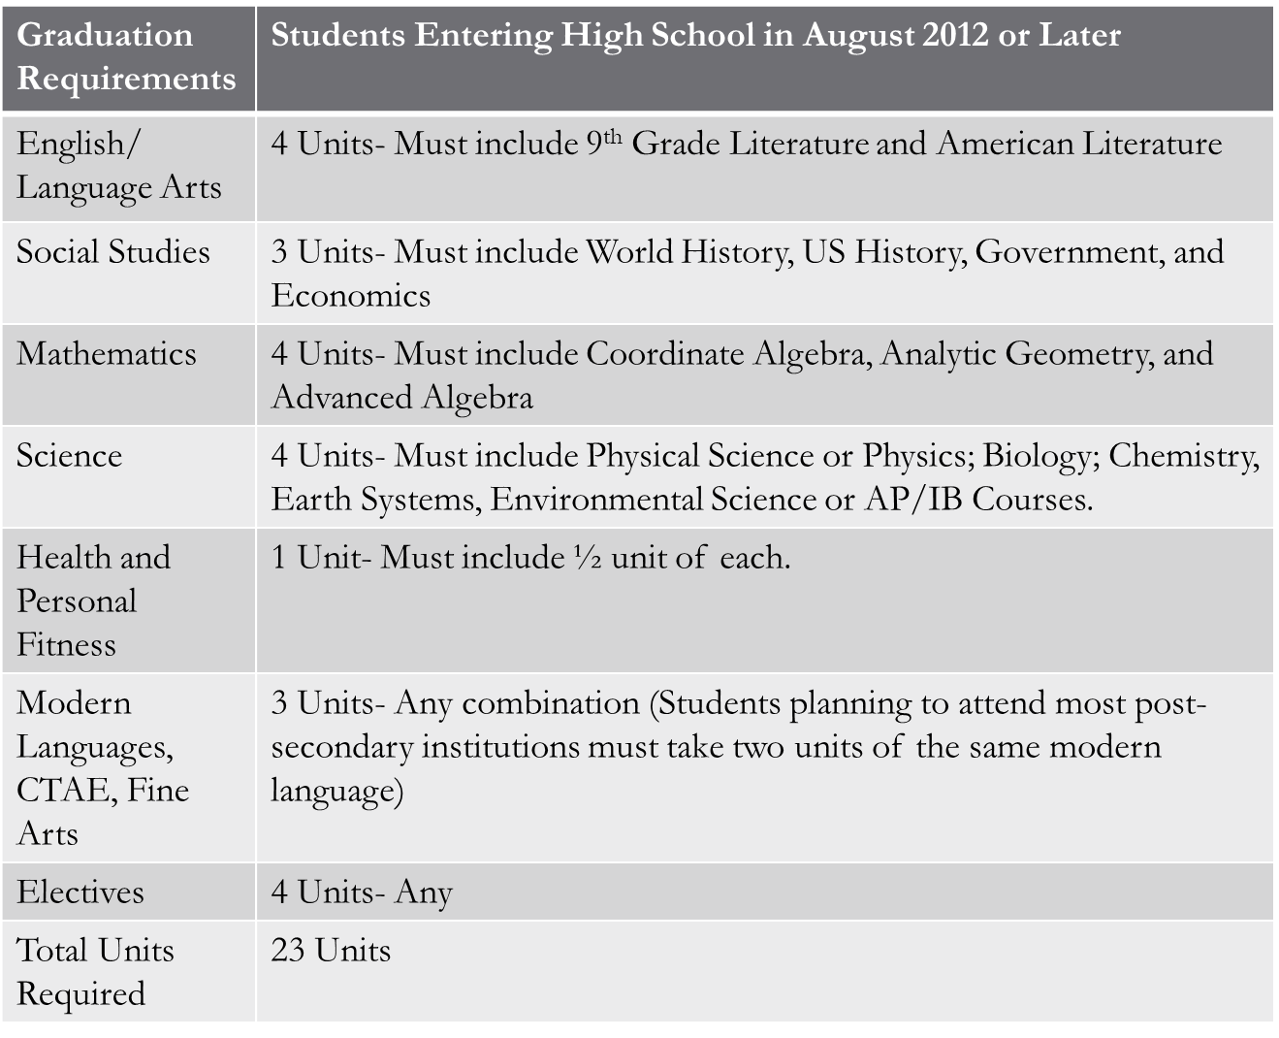
Graduation Requirements
For promotion to 11th grade, you need a total of12 credits and they must include 2 Core English, 2 Core Math, 2 Core Sciences, and 1 Core Social Studies
For promotion to 12th grade, you need a total of 18 credits and they must include 2 Core English, 3 Core Math, 2 Core Sciences, and 1 Core Social Studies
To Graduate, you need a total of 23 credits. See Table to the right for a breakdown of requirements.

Slide 6
A few Things to consider
Colleges care about rigor!
if you are making all A’s in regular classes, talk to your teachers about honors level
If you are in honors level courses, talk to your teachers about taking an AP course or Dual enrollment
Earning 3 or more credits in a modern language
Two thirds of employers report cross-cultural competence as one of their top desired skills in an employee. (Brooks, Business News Daily, March 2013)
International skills diploma seal – see Mrs. Diaz for more details
Earn a pathway skills seal
earn credit for 3 courses in the same CTAE pathway
Pass the end-of-pathway assessment

Slide 7
Discussion: challenging yourself
As discussed in your Social Studies classes last week & previous slide, colleges care about course rigor. With registration coming up in a few weeks, ask yourself,
Am I taking the most rigorous courses that I am capable of (Honors, AP, or Dual Enrollment?) OR could I challenge myself more next year?

Slide 8
Reflection:
Using your agenda or your phone, write down THREE WAYS you will challenge yourself Junior year to help you prepare for college.

