Slide 1
Preparing for registration
1/30 Advisement

Slide 2
Important Upcoming 2019-2020 Registration dates:
February 19 – Registration Begins
Extended advisement for students to receive Course Planning Guides and complete 4-year Graduation Plan
February 19-22 Registration Events in Theatre Lobby during lunch
Tuesday – Juniors
Wednesday – Sophomores
Thursday – Freshmen
Friday – Make-Ups

Slide 3
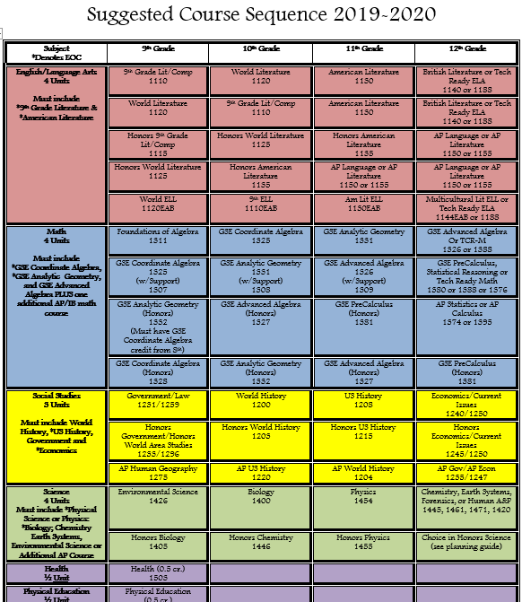
High School Graduation Plan
Today you will fill out a Course plan of study to help you prepare for registration on February 19th.
For this activity, plan as if you will pass all of your current classes

Slide 4
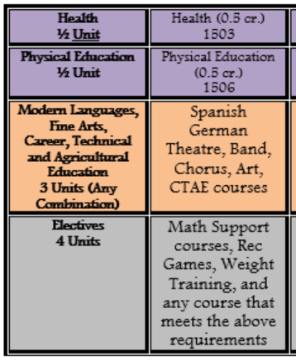
instructions
Login to your infinite campus to view your transcript and current course schedule
On the course sequence guide,
Mark an “X” on courses already passed
Mark a “ “ on current courses
Circle courses you plan to take next year
plans will look different for all students. This Is only meant to serve as a general guide for your core classes.
Please Make sure your plan meets all graduation requirements, Listed on the back of your course sequence.
Double check with your teacher or your counselor if you have questions
*if you are planning to take AP Seminar or AP Research, these need to be completed in addition to the four core English courses listed on the guide

Slide 5
A few Things to consider
Colleges care about rigor!
if you are making all A’s in regular classes, talk to your teachers about honors level
If you are in honors level courses, talk to your teachers about taking an AP course or Dual enrollment
Earning 3 or more credits in a modern language
Two thirds of employers report cross-cultural competence as one of their top desired skills in an employee. (Brooks, Business News Daily, March 2013)
International skills diploma seal – see Mrs. Diaz for more details
Earn a pathway skills seal
earn credit for 3 courses in the same cTAE pathway
Pass the end-of-pathway assessment

Slide 6
Next steps
Still have scheduling questions? Talk to your teachers and/or visit your school counselor, Ms. Hamilton, for more help
Keep your graduation plan somewhere you will remember so you can refer to it when registering for classes

